Slide 1
UpGrad & IIIT-B,
Clustering Assignment
International humanitarian Aid
By,
Sushil Deore

Slide 2
Agenda:
Problem Statement
Analysis Approach
Findings from EDA and clustering model
Final list of countries
Recommendations

Slide 3
Problem Statement
HELP International is an international humanitarian NGO that is committed to fighting poverty and providing the people of backward countries with basic amenities and relief during the time of disasters and natural calamities.
After the recent funding programs, they have been able to raise around $ 10 million. Now the CEO of the NGO needs to decide how to use this money strategically and effectively. The significant issues that come while making this decision are mostly related to choosing the countries that are in the direst need of aid.
Objectives:
To categories the countries using some socio-economic and health factors that determine the overall development of the country.
To suggest the countries which the CEO needs to focus on the most.

Slide 4
Analysis Approach
Reading and understanding the data
Inspecting dataset using data visualization
Bivariate analysis
Multivariate Analysis
Comparison with Target variable- Country
Distribution plot for clustering Profiling
Data Preparation
Rescaling
Checking Clustering tendency using Hopkins Check
KMeans Clustering
Choosing Optimal k for K-Means clustering using,
Elbow Curve- SSD
Silhouette Analysis
Application of KMeans on scaled data
Cluster visualization- With All Variables
Hierarchical Clustering
Single linkage
Complete linkage
Cluster visualization- With All Variables

Slide 5
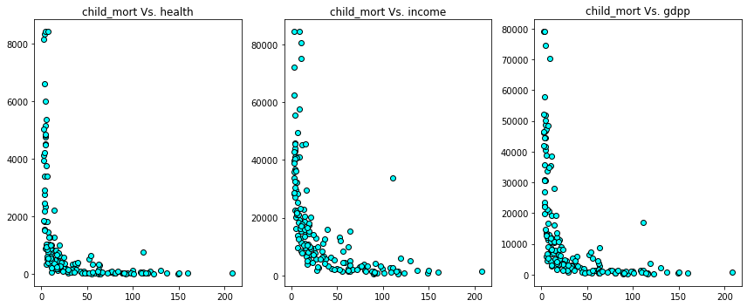
Exploratory Data Analysis
Bi-Variate Analysis:
Inference:
- Child mortality rate is less with less spending on health.
- Child mortality rate is less with less income.
- Child mortality rate is less with low GDP per capita.

Slide 6
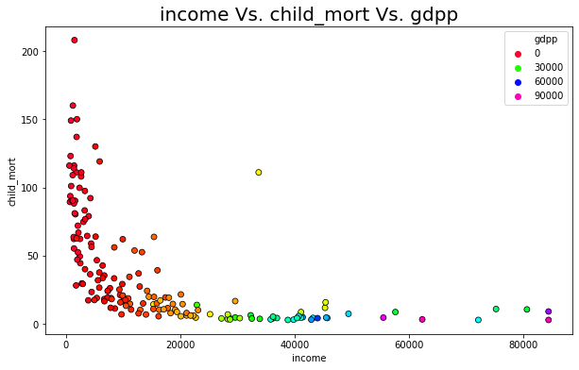
Exploratory Data Analysis
Multivariate analysis
Inference:
- Child mortality rate is less with less income and less GDP.

Slide 7
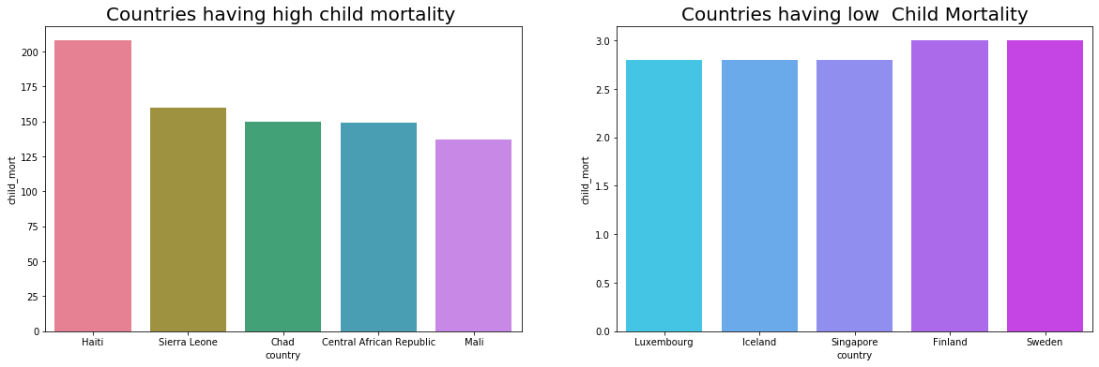
Exploratory Data Analysis
Comparison with Target Variable – Country Vs. Child Mortality
Inference:
- Haiti is a country with highest child mortality.
- Luxembourg and Iceland are the countries with less child mortality.

Slide 8
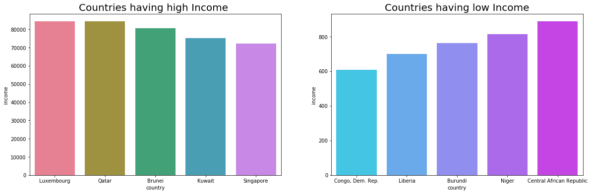
Exploratory Data Analysis
Comparison with Target Variable – Country Vs. Income
Inference:
- Net income per person is highest for Luxembourg & Qatar.
- Net income per person is lowest for Congo.Dem. Rep.

Slide 9
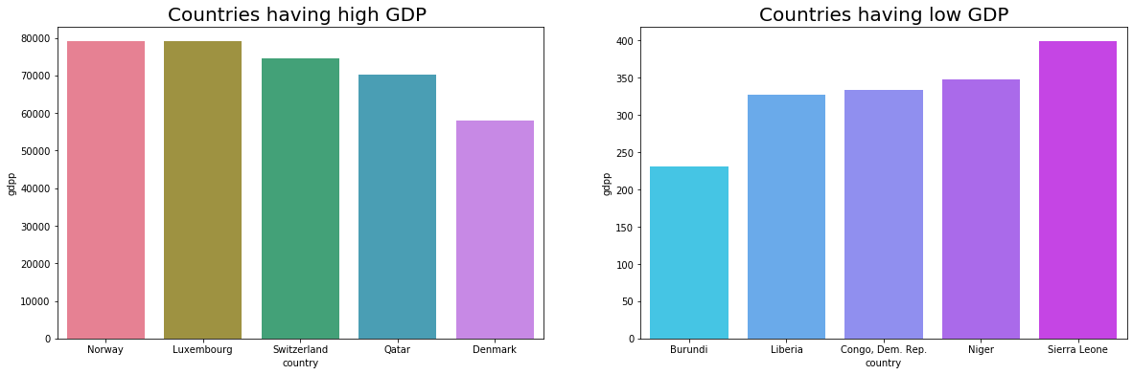
Exploratory Data Analysis
Comparison with Target Variable – Country Vs. GDP
Inference:
- We can see that Norway & Luxembourg has highest GDP per capita.
- Burundi has very less GDP per capita.

Slide 10
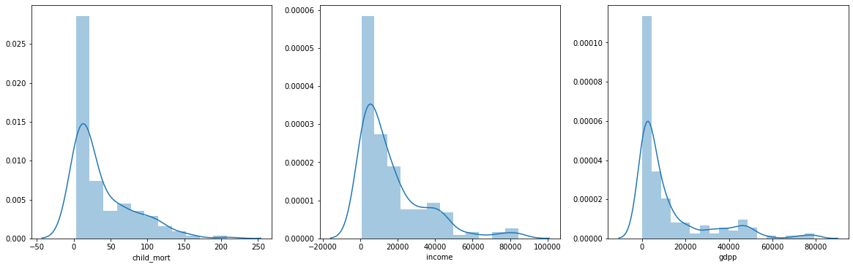
Exploratory Data Analysis
Distribution plot for clustering Profiling
Inference:
- Child Mortality, Income and GDP are the three columns that have a variation in the data.
- Hence we can consider these three columns for cluster profiling.

Slide 11
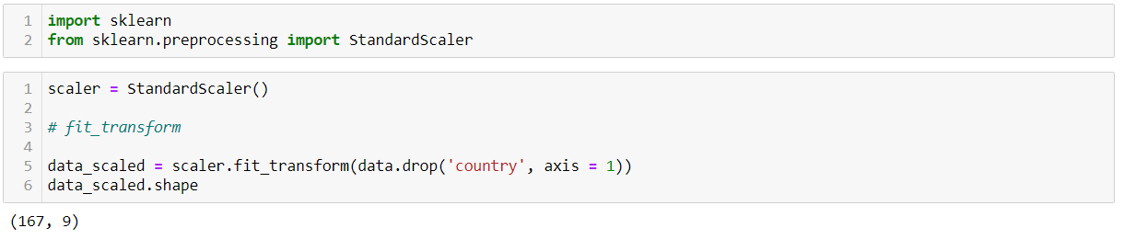
Data Preparation
Rescaling
From sklearn.preprocessing library importing StandardScaler
Instantiating the object
Performing fit_transform on data (dataframe excluding categorical variables)

Slide 12
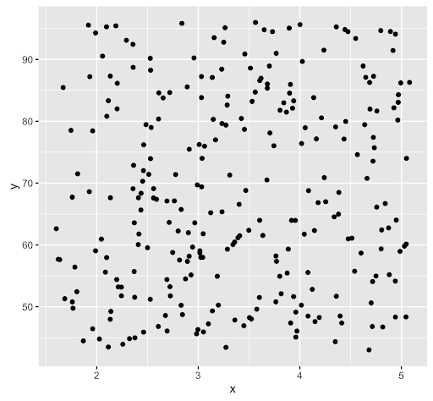
Data Preparation
Hopkins Check
It is the method to check the clustering tendency for unsupervised machine learning.
So, function Hopkins compare scatter spread of data points from “data” to Random scatter data which contains no cluster tendency or properties. Using NearestNeighbors.
Hopkins test tells us that how much percentage different is our data from random scatter data.
we can perform Hopkins test before scaling or after the scaling as the scale of x-axis & y-axis changes it does not affect the spread of points.
Random Scatter data

Slide 13
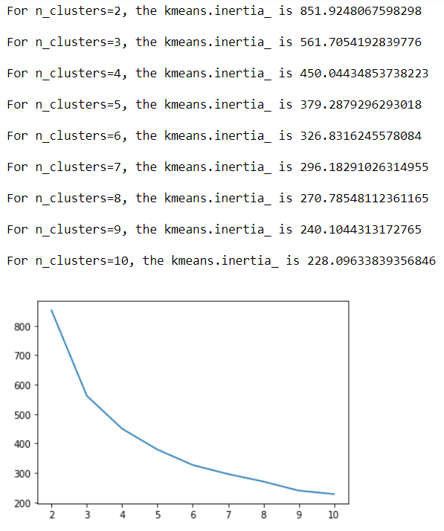
K-Mean Clustering
Elbow-Curve/ SSD:
Elbow-Curve : Uses KMeans inertia. So KMeans algorithm clusters data by trying to separate samples in n groups of equal variance, minimizing a criterion known as the inertia or within-cluster sum-of-squares.
Inertia can be recognized as a measure of how internally coherent clusters are.

Slide 14
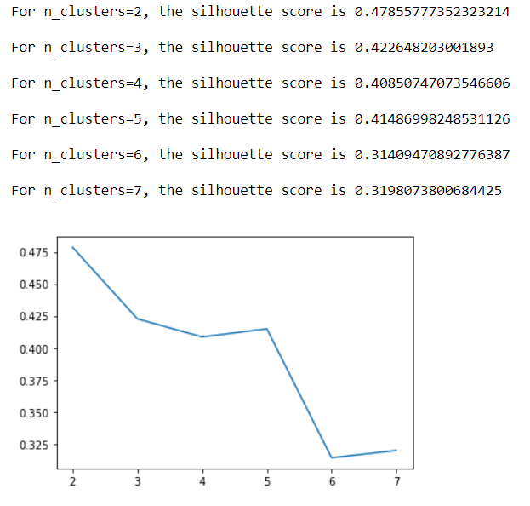
K-Mean Clustering
Silhouette analysis
$$suilhouette analysis=(p−q)/(\max\left(p,q\right))$$
p is the mean distance to the points in the nearest cluster that the data point is not a part of
q is the mean intra-cluster distance to all the points in its own cluster.
The value of the silhouette score range lies between -1 to 1.
A score closer to 1 indicates that the data point is very similar to other data points in the cluster,
A score closer to -1 indicates that the data point is not similar to the data points in its cluster

Slide 15
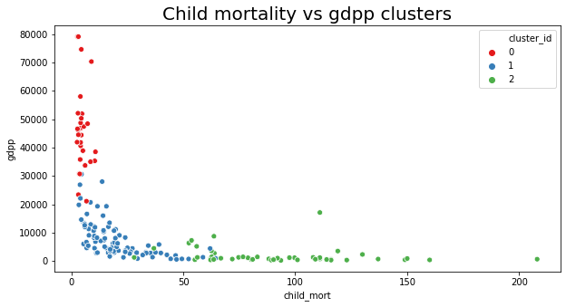
K-Mean Clustering
Cluster visualization
Inference:
- For cluster 2 have low GDP but high child mortality.

Slide 16
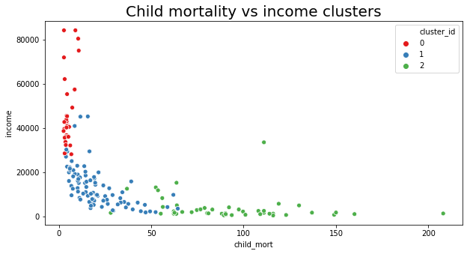
K-Mean Clustering
Cluster visualization
Inference:
- For cluster 2 have low income but high child mortality.

Slide 17
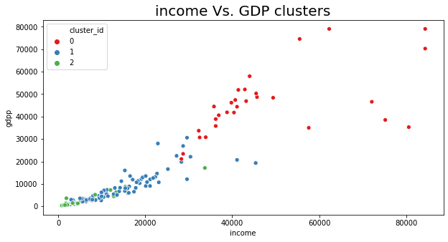
K-Mean Clustering
Cluster visualization
Inference:
- For cluster 2 have low GDP and low income.

Slide 18
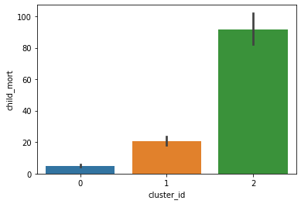
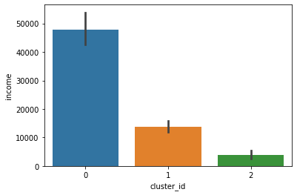
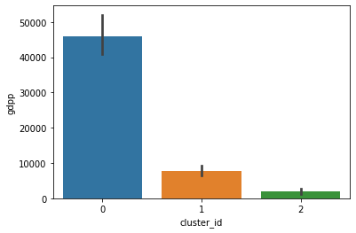
K-Mean Clustering
Cluster visualization : Child mortality, income, GDP w.r.t. clusters
Inference: Using K-Means:
- Cluster 0 is having the High income, High GDP and very Low child mortality.
- Cluster 1 is having low income, GDP and less child mortality.
- Cluster 2 is having very Low income, very Low GDP but High child mortality.

Slide 19
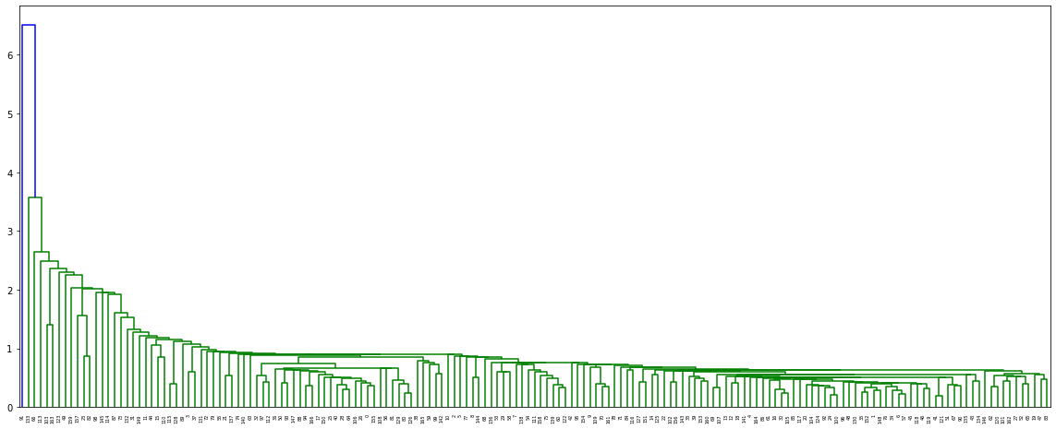
Hierarchical Clustering
Single linkages :In single-link (or single linkage) hierarchical clustering, we merge in each step the two clusters whose two closest members have the smallest distance (or: the two clusters with the smallest minimum pairwise distance).

Slide 20
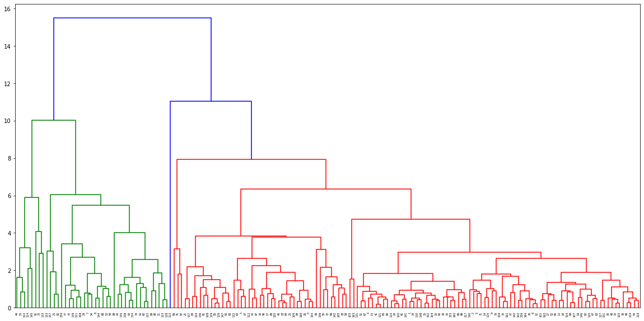
Hierarchical Clustering
Complete linkages : Distance defined as the distance of the two closest members is a local property that is not affected by merging; distance defined as the diameter of a cluster is a non-local property that can change during merging.

Slide 21
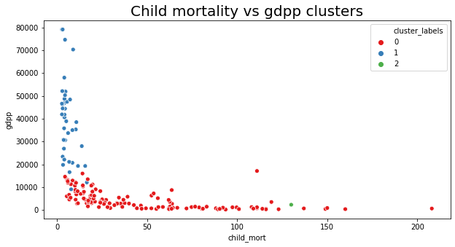
Hierarchical Clustering
Cluster visualization
Inference:
- For cluster 0 have low GDP and low income.

Slide 22
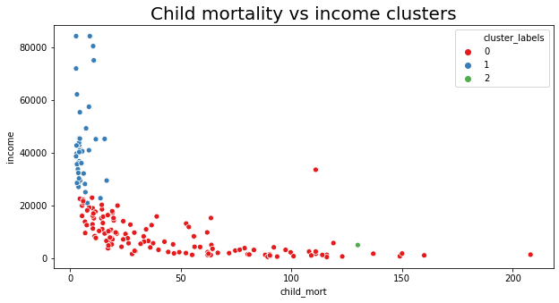
Hierarchical Clustering
Cluster visualization
Inference:
- For cluster 0 have low GDP and low income.

Slide 23
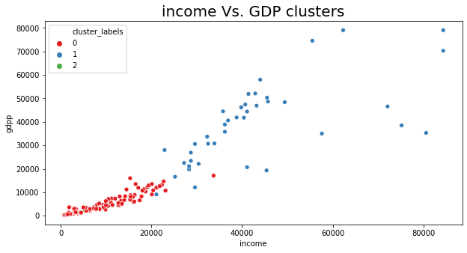
Hierarchical Clustering
Cluster visualization
Inference:
- For cluster 0 have low GDP and low income.

Slide 24
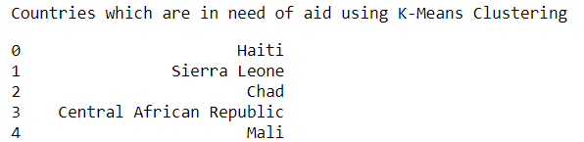
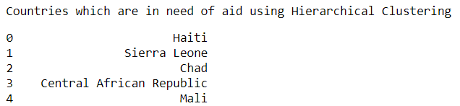
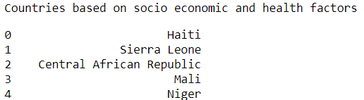
Final List of Countries:

Slide 25
Recommendations
From the analysis performed, We can see that low income people have high child mortality, so CEO must focus more on low income countries.
CEO must focus more on Central African Republic, Niger where the total health spending is too less.
Haiti is the country having very low life expectancy and high child mortality.

